Slide 1


SHOP THE LATEST TRENDS!
FASHIONABLE CLOTHING AND ACCESSORIES FOR THE YOUNG AND STYLISH.

Slide 2
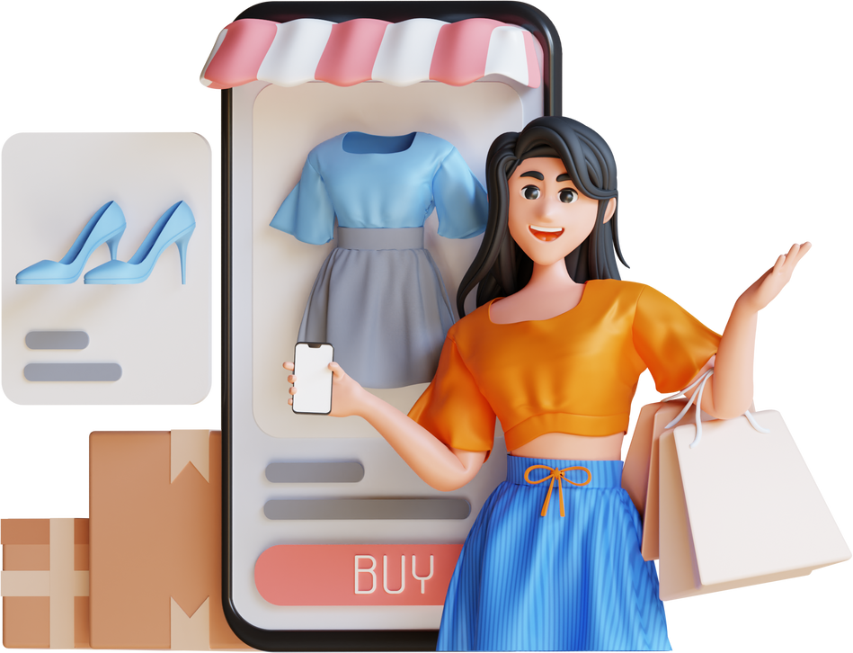

INTRODUCING MONDO-MARKET - YOUR ONE-STOP SHOP FOR EVERYTHING YOU NEED

Slide 3

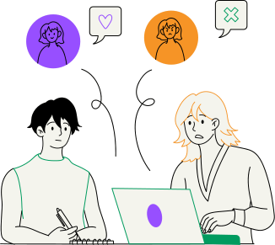

Slide 4
SUBJECT: SOCIAL MEDIA MARKETING CAMPAIGN FOR MONDOMARKET
Dear [Manager's Name],
I am excited to present OUR SOCIAL MEDIA MARKETING CONTENT STRATEGY FOR MONDOMARKET AIMED AT CAPTURING THE ATTENTION AND ENGAGEMENT OF OUR TARGET AUDIENCE: 18-35-YEAR-OLDS LIVING IN THE UK. OUR APPROACH FOCUSES ON CREATING VISUALLY APPEALING, INTERACTIVE, AND COMPELLING CONTENT TAILORED TO THE PREFERENCES AND BEHAVIORS OF YOUNG SOCIAL MEDIA USERS.
HERE'S WHY WE HAVE DESIGNED OUR CONTENT IN THIS WAY:
  ENGAGING VIDEO ADVERTISEMENTS: WE UNDERSTAND THAT VIDEO CONTENT PERFORMS EXCEPTIONALLY WELL ON SOCIAL MEDIA PLATFORMS LIKE FACEBOOK AND INSTAGRAM. BY CRAFTING SHORT, ATTENTION-GRABBING VIDEO ADS, WE AIM TO SHOWCASE THE UNIQUE FEATURES AND BENEFITS OF MONDOMARKET IN A VISUALLY COMPELLING MANNER.
  INTERACTIVE POLLS AND QUIZZES: WE RECOGNIZE THE IMPORTANCE OF FOSTERING ACTIVE ENGAGEMENT AND INTERACTION WITH OUR AUDIENCE. BY INCORPORATING INTERACTIVE POLLS AND QUIZZES, WE ENCOURAGE USERS TO PARTICIPATE ACTIVELY WHILE GAINING VALUABLE INSIGHTS INTO THEIR PREFERENCES AND BEHAVIORS.
  USER-GENERATED CONTENT CONTESTS: LEVERAGING USER-GENERATED CONTENT NOT ONLY FOSTERS A SENSE OF COMMUNITY BUT ALSO GENERATES AUTHENTIC CONTENT THAT RESONATES WITH OUR AUDIENCE. THROUGH USER-GENERATED CONTENT CONTESTS, WE EMPOWER USERS TO SHARE THEIR MONDOMARKET EXPERIENCES AND BECOME BRAND ADVOCATES.
  LIMITED-TIME OFFERS AND PROMOTIONS: CREATING A SENSE OF URGENCY IS KEY TO DRIVING IMMEDIATE ACTION AND CONVERSION. BY OFFERING EXCLUSIVE LIMITED-TIME DEALS AND PROMOTIONS, WE INCENTIVIZE USERS TO SIGN UP FOR MONDOMARKET AND TAKE ADVANTAGE OF THESE COMPELLING OFFERS.
OVERALL, OUR GOAL IS TO CREATE A DYNAMIC AND ENGAGING SOCIAL MEDIA PRESENCE FOR MONDOMARKET THAT RESONATES WITH OUR TARGET AUDIENCE AND DRIVES MEANINGFUL RESULTS IN TERMS OF USER ENGAGEMENT AND REGISTRATION.
THANK YOU FOR YOUR SUPPORT, AND I LOOK FORWARD TO THE SUCCESS OF OUR SOCIAL MEDIA MARKETING CAMPAIGN.
BEST REGARDS, NORIKA HEATHDALE
ATTACHED, PLEASE FIND THE SOCIAL MEDIA CONTENT ASSETS FOR YOUR REVIEW.
BEST REGARDS, NORIKA HEATHDALE

